Slide 1
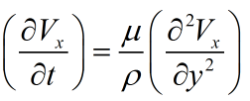

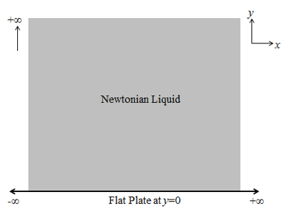





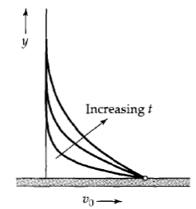

Stoke’s 1st Problem:
Flat-Plate being pulled with
Constant Velocity
Momentum
Diffusivity
fully
developed
Velocity
driven flow
fully
developed
z is infinite
in
both directions

Slide 2

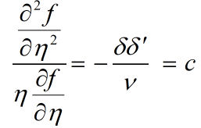







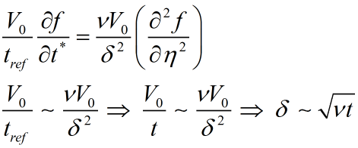


Order of magnitude analysis
Momentum
Diffusion length scale

Slide 3




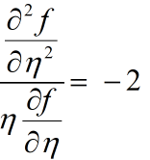

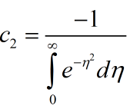




Initial
condition
Boundary
condition

Slide 4




